Slide 1
BATCH 2 WEEK 3 REPORT

Slide 2
This weeks objectives:
Ascertain the credibility of the use of bolts in holding the nozzle and the bulkhead
Test the load cell instrumentation system
Prepare one propellant grain
Search for a material to fabricate an N2 case

Slide 3
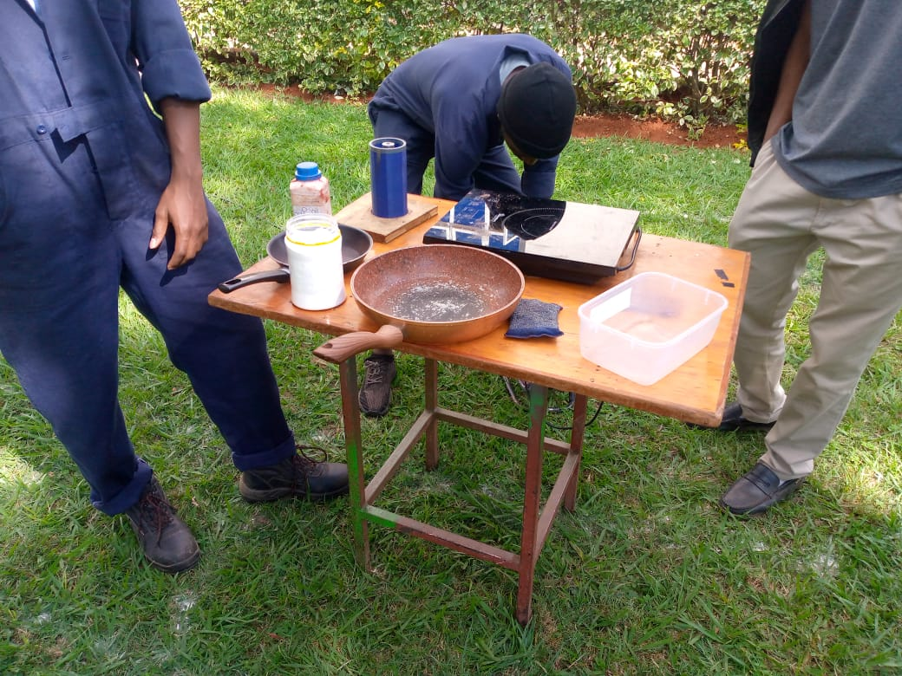

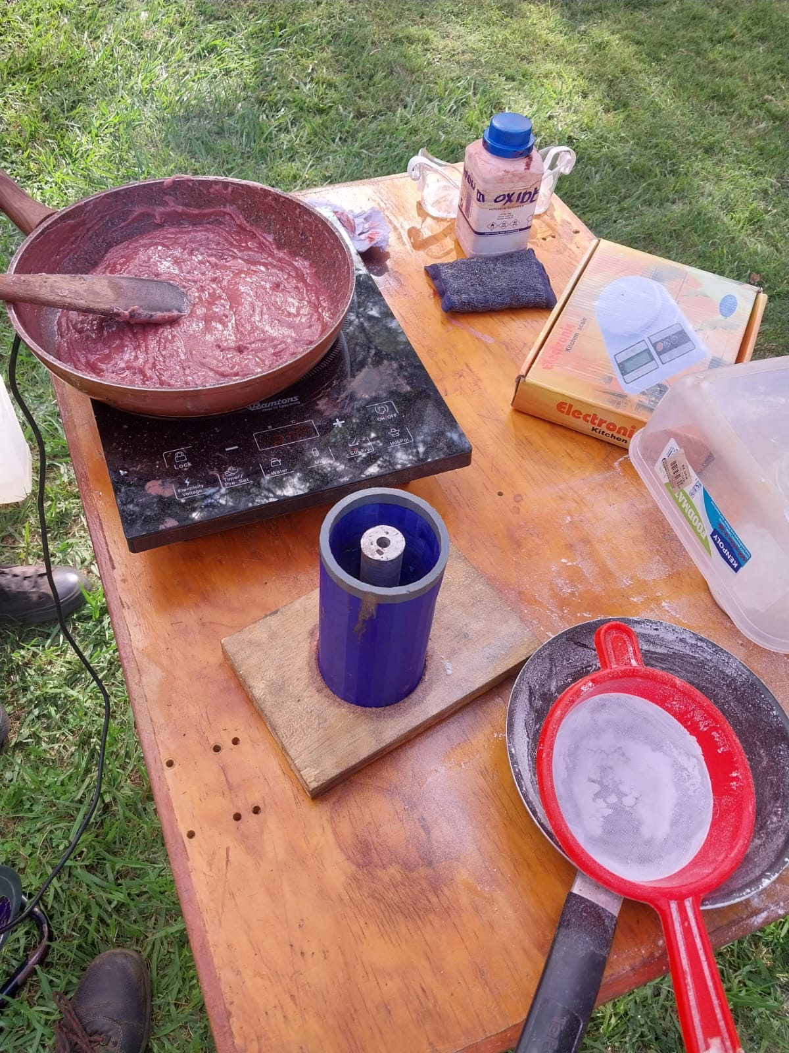
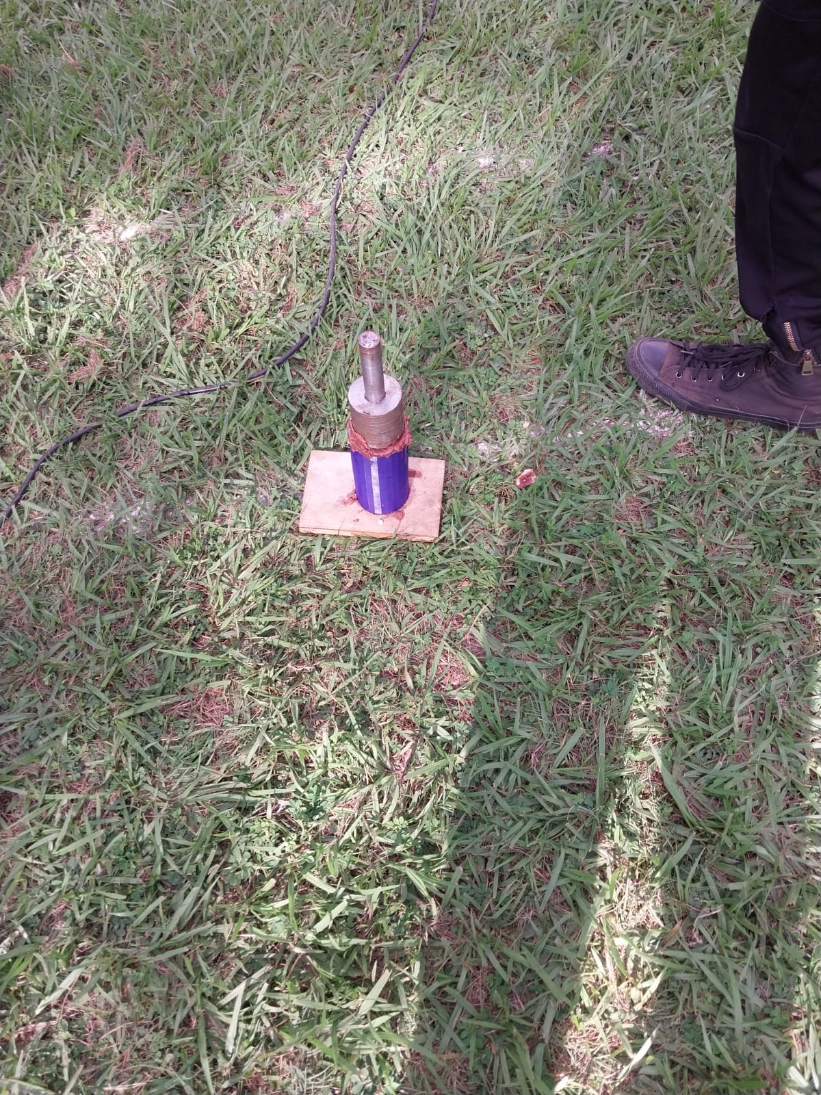

Slide 4
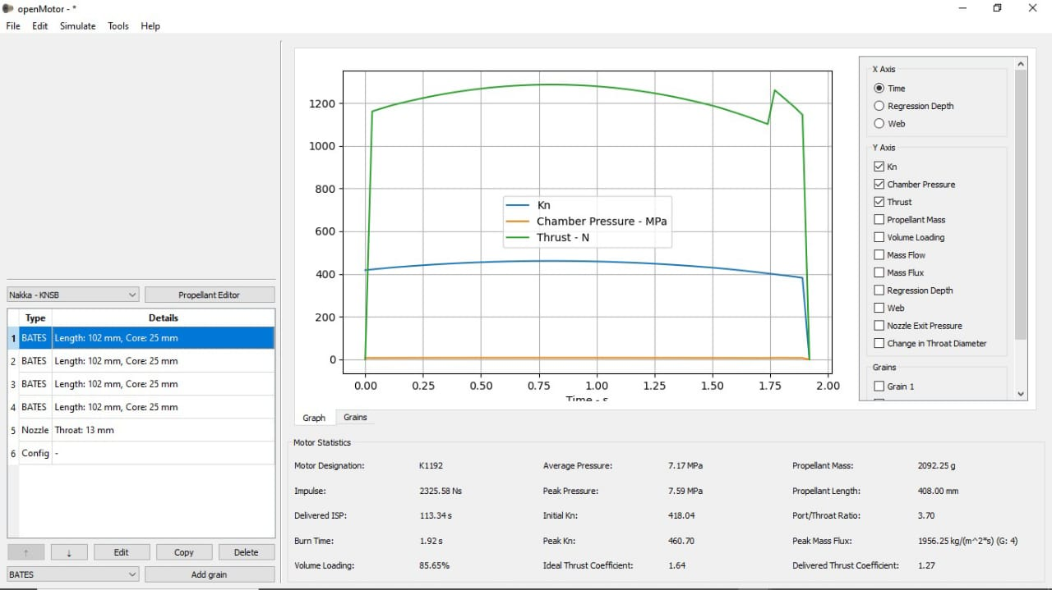
Open motor simulation:
Finding: peak chamber pressure 7.59 MPa

Slide 5

Converting the chamber pressure to force (F):
$$=chamber pressure×cross area=(7.59×{10}^{6})×(π×{\left(0.034\right)}^{2})$$
FORCE GENERARED = 27564 N
Bolt surface area subjected to the shear force:
$$=8×π×{\left(3 ×{10}^{−3}\right)}^{2}=2.262{ ×{10}^{−4}m}^{2}$$
Shear stress generated on the bolts:
$$=\frac{FORCE}{AREA}=\frac{27564}{2.262×{10}^{−4}}= 122MPa$$
FINDING:
Since the shear yield strength of stainless steel is 303MPa
Achieving a safety factor=2.97

Slide 6
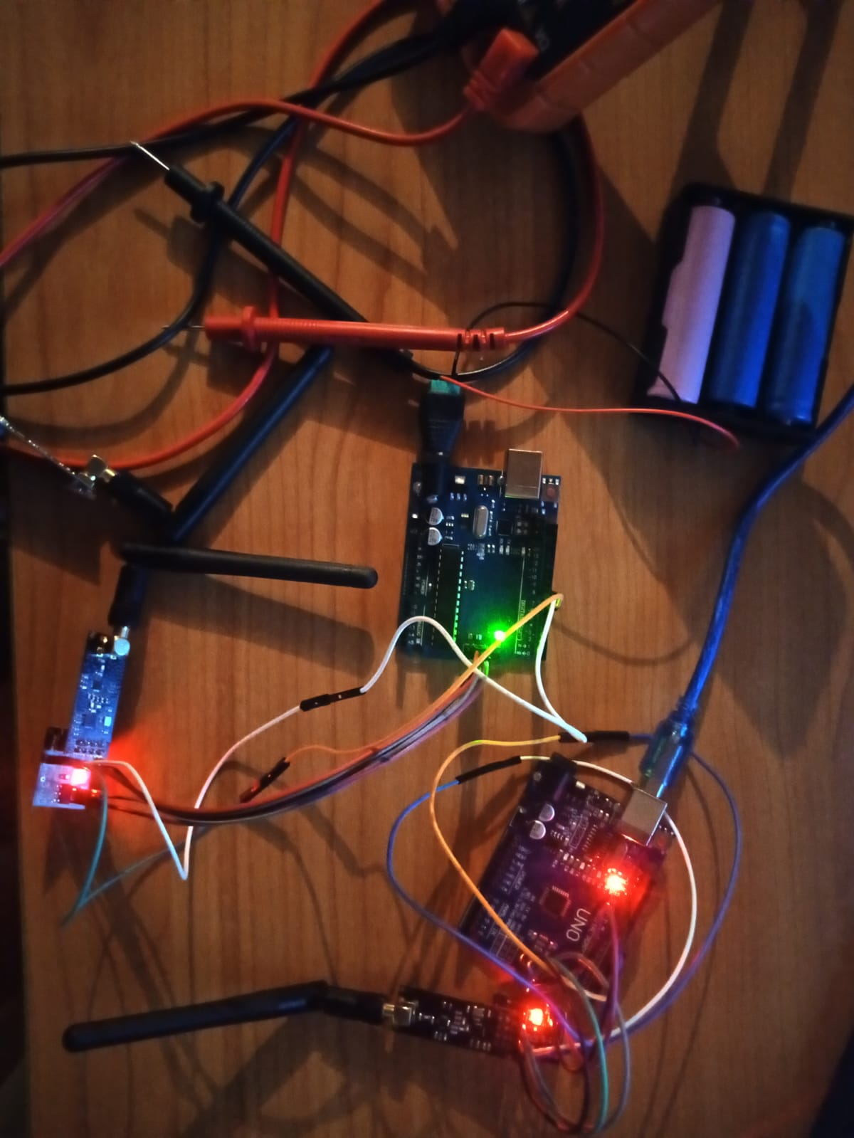
Load cell testing:
Issues:
Nrf24101+ module transmits noisy data
Suggested solution:
Utilize EEPROM(AT24C256) to temporarily store data

Slide 7
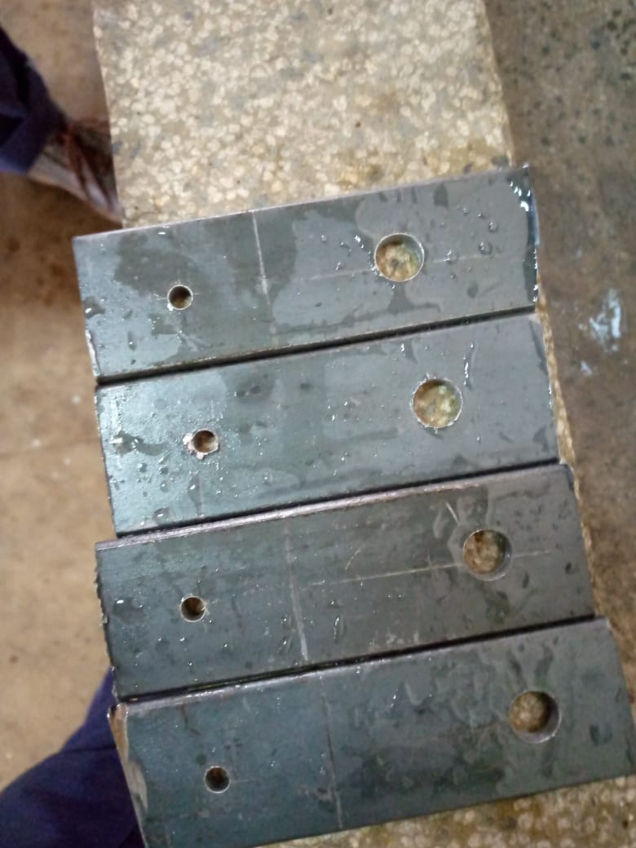
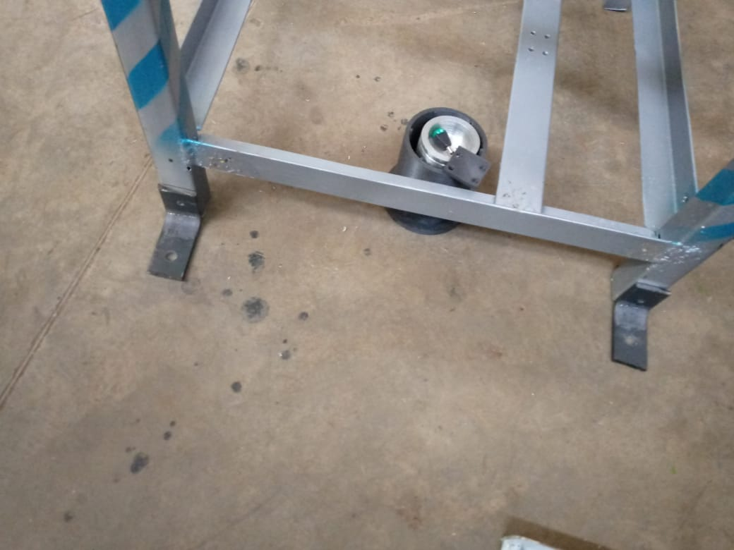
THE TEST STAND SUPPORTS
Settled on bolting as a means of connecting the supports as opposed to welding

Slide 8

Next weeks objectives:
Melt and recast the previous cooked grains
Continue search for a 2$1/2" SCH40 pipe$ for the N2 case
Modify the test stand to accommodate the N2 motor
Continue testing the loadcell instrumentation system

